Slide 1
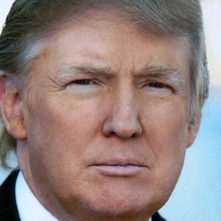
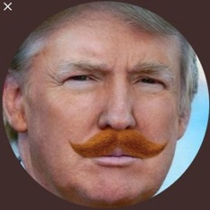


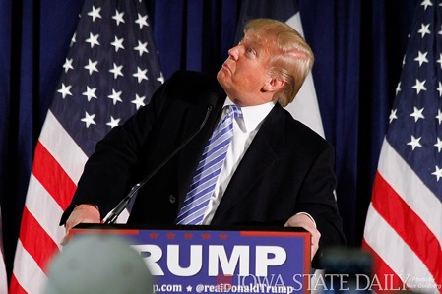
Will the @realDonaldTrump please stand up?
How keyword squatting steals attention from the president on Twitter
Shawn M. Jones
Los Alamos National Laboratory Library Prototyping Team
Web Science and Digital Libraries Research Group
CS895: Web Archiving Forensics Fall 2020

Slide 2
The title comes from an Eminem song where he’s complaining about other artists copying his work…
…
I'm Slim Shady, yes I'm the real Shady All you other Slim Shadys are just imitating So won't the real Slim Shady please stand up Please stand up, please stand up?
…
Eminem “The Real Slim Shady” 2000

Slide 3
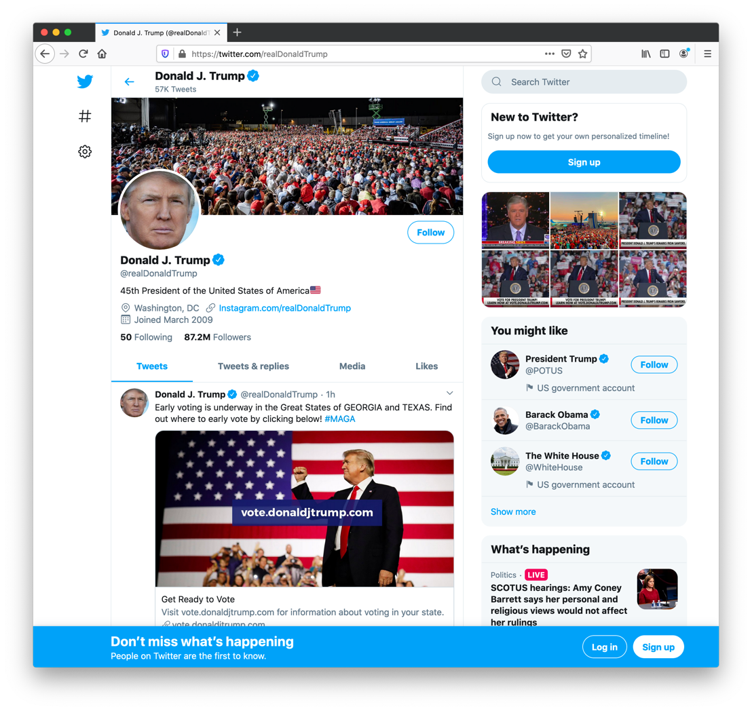
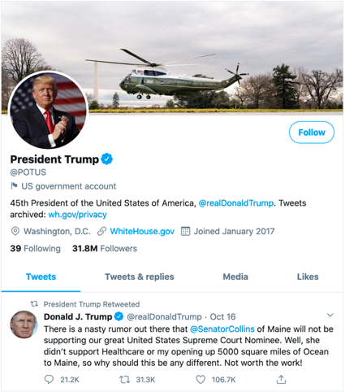
@realDonaldTrump
The Twitter account of the 45th President of the United States
Created March 2009
87.2M followers
Following 50
Verified Account
Often retweeted by @POTUS

Slide 4
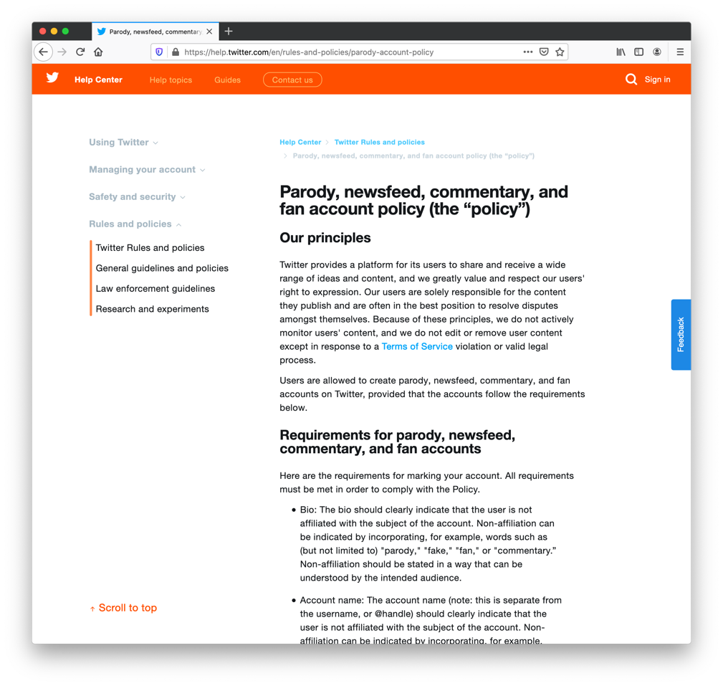
Twitter has rules for parody accounts
Bio “should clearly state that this account is not affiliated with the real account”
“The account name should clearly indicate that the user is not affiliated with the subject of the account”
Per Carbon Date, this URL was published on December 12, 2017
https://help.twitter.com/en/rules-and-policies/parody-account-policy

Slide 5
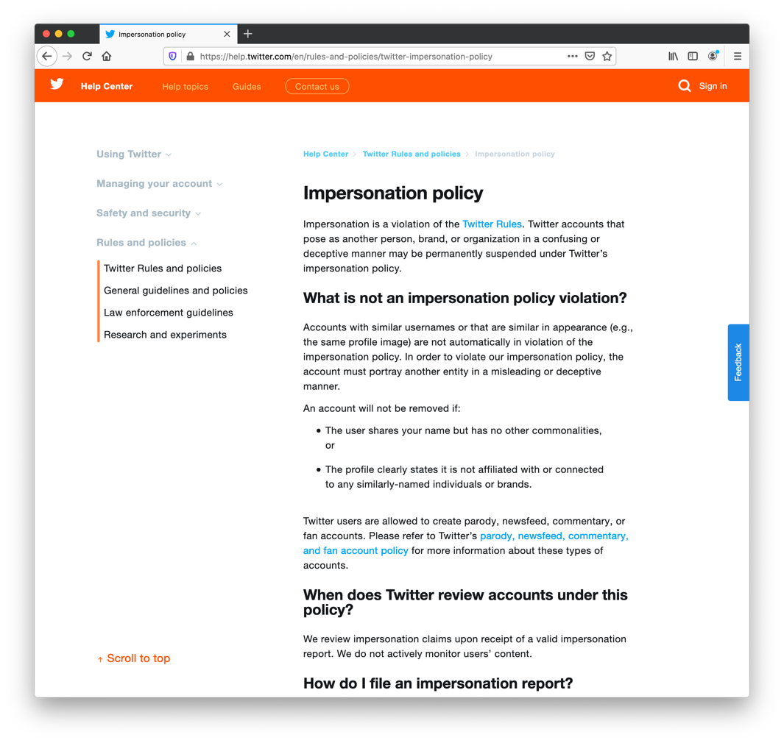
Impersonation is a violation of Twitter’s rules
An account will not be removed if:
The user shares your name but has no other commonalities or
The profile clearly states it is not affiliated or connected to any similarity-named individuals or brands
Per Carbon Date, this URL was published on December 18, 2017
https://help.twitter.com/en/rules-and-policies/twitter-impersonation-policy

Slide 6
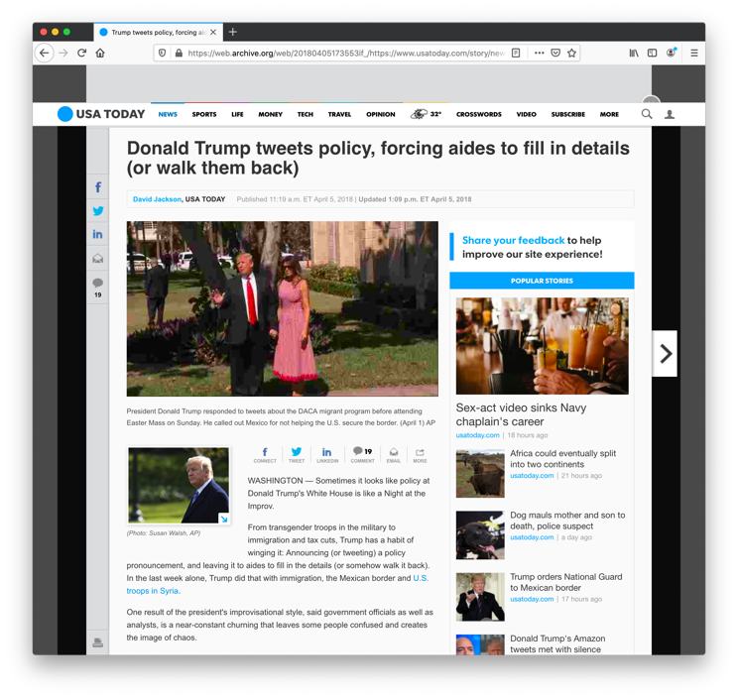
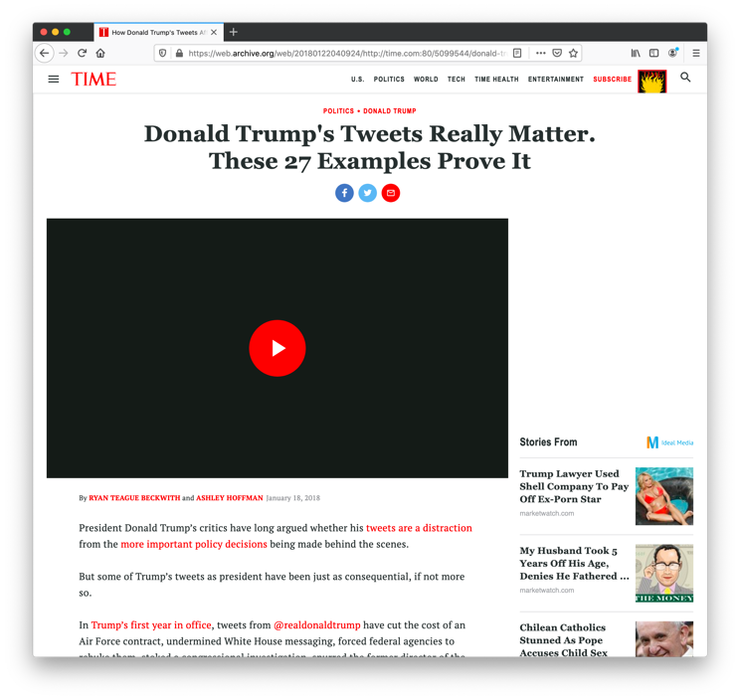
Mistaking fake accounts for the real one matters because Trump issues policy from his tweets
https://web.archive.org/web/20180405173553if_/https://www.usatoday.com/story/news/politics/2018/04/05/trump-tweets-policy-aides-have-fill-details-walk/485433002/
https://web.archive.org/web/20180122040924/http://time.com:80/5099544/donald-trump-tweets-first-year/?

Slide 7
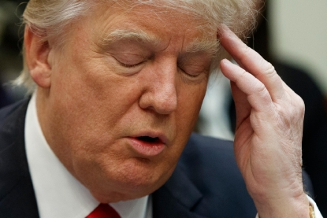
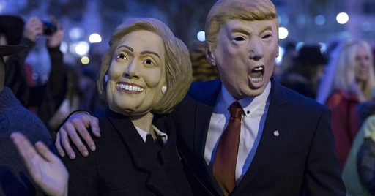
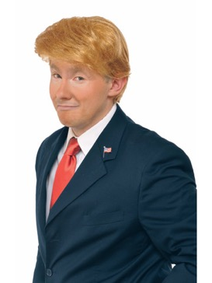
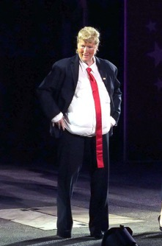
Could someone mistake another account for @realDonaldTrump?

Slide 8

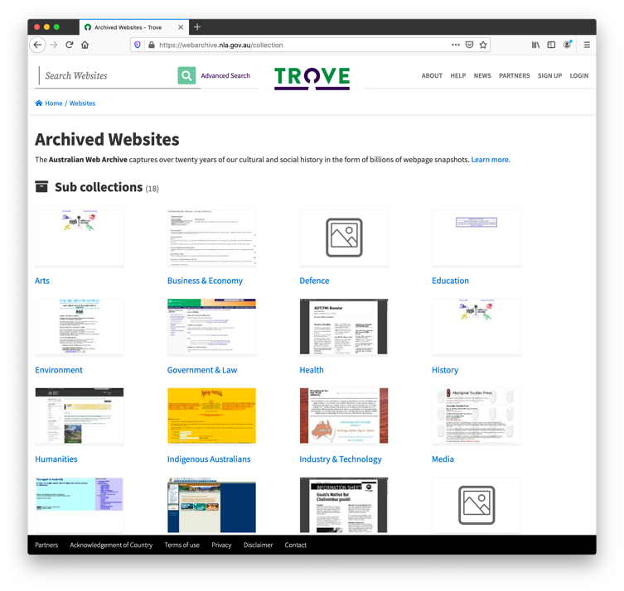
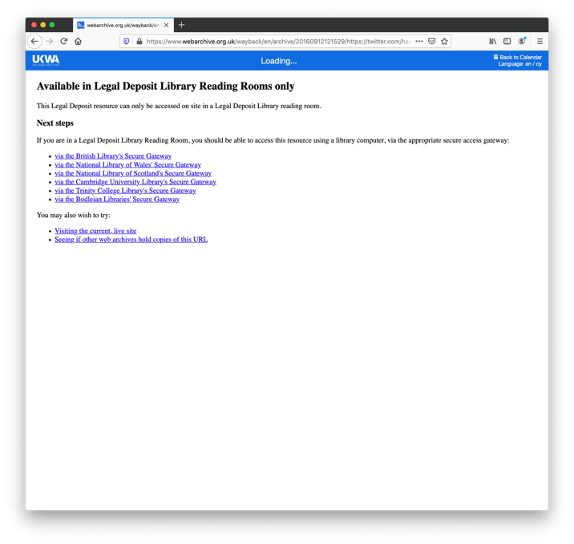
I used different methods to find usage of fake Trump accounts
Twint for acquiring lists of verified Twitter accounts that mention the fake account
Twitter API for getting information about verified accounts
Google for finding news articles, but web archives for verifying content
Twitter search for tweets using the fake account name
Used full text search of Arquivo.pt and National Library of Australia
UK Web Archive full text search results were not available via the Web
LANL TimeTravel service for finding mementos of URI-Rs
I created mementos for items that were not yet archived

Slide 9
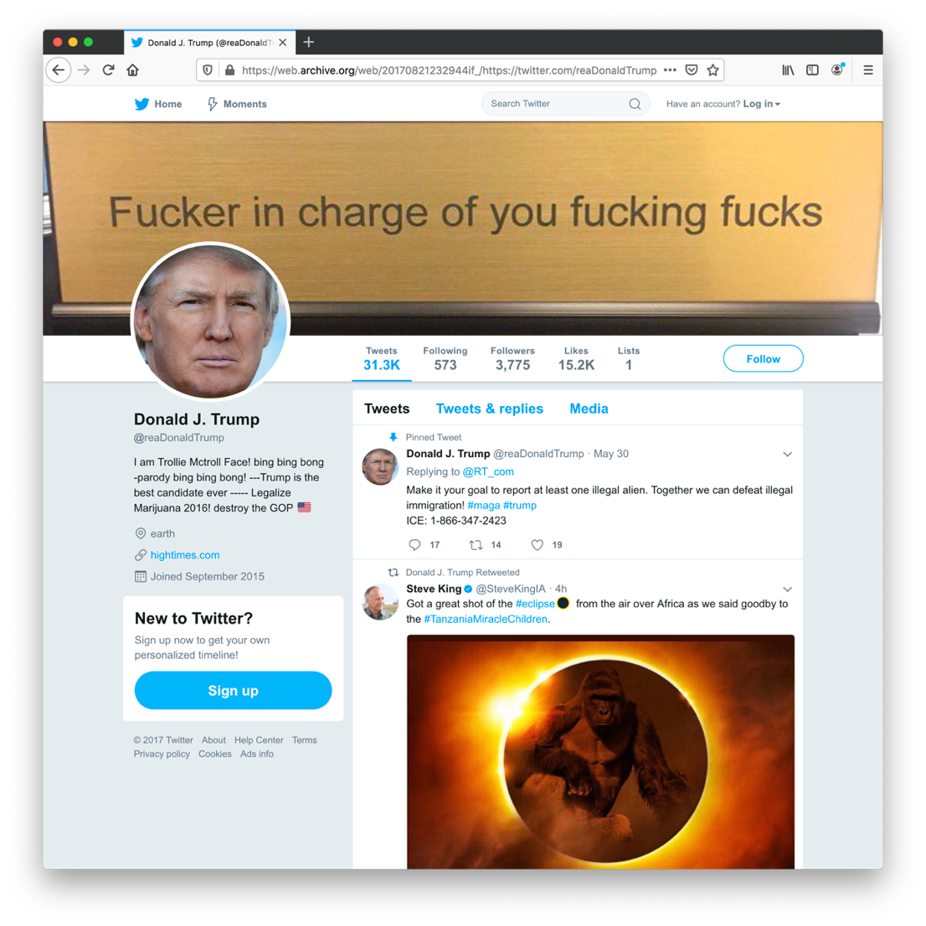
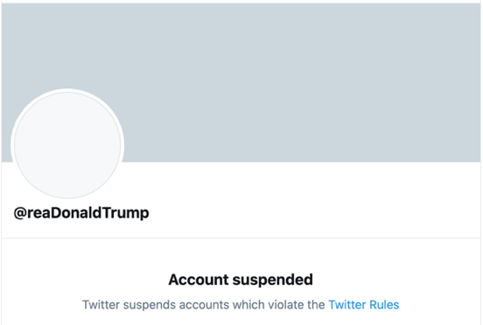
@reaDonaldTrump
Created September 2015
3,775 followers in 2017
Following 573
Clearly a parody account
Often mistaken for @realDonaldTrump due to users missing the lowercase “L” in “real” before “Donald”
Suspended by Twitter in 2018

Slide 10
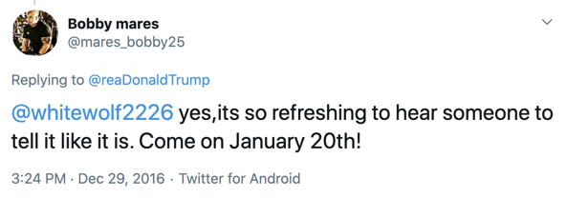

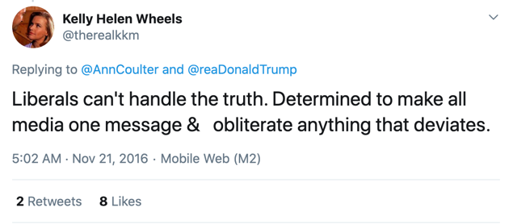
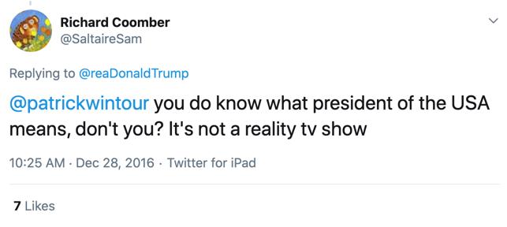

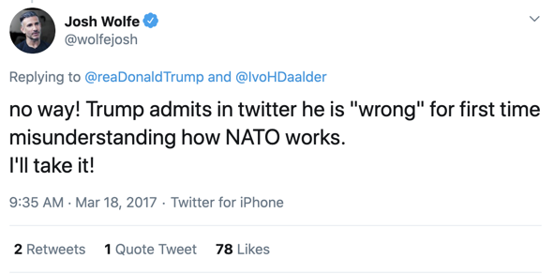
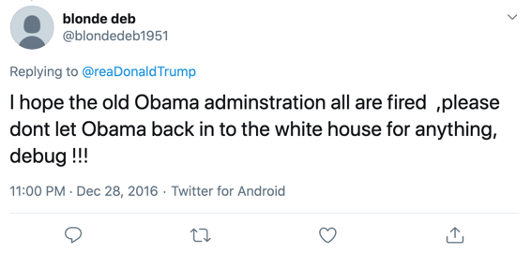
People replied to @reaDonaldTrump as if they were talking to @realDonaldTrump
Endorsed by Other Accounts

Slide 11
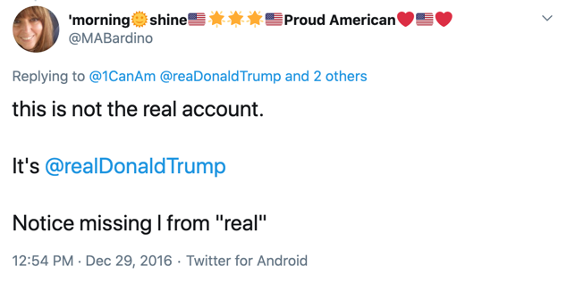
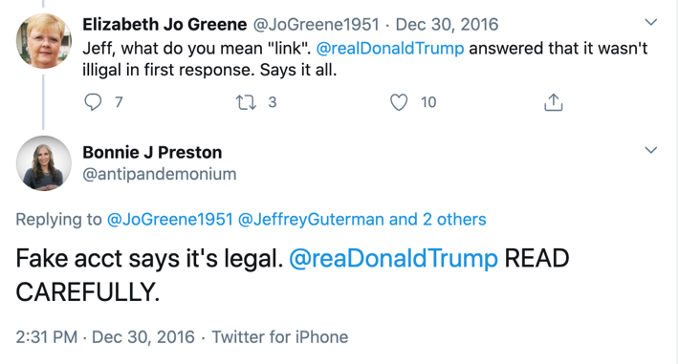
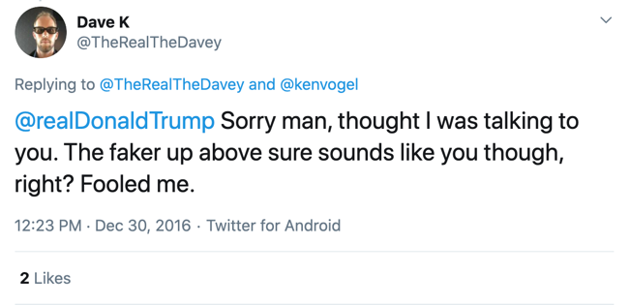
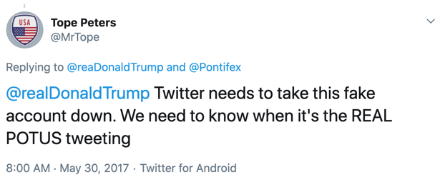
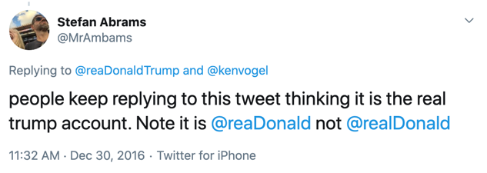
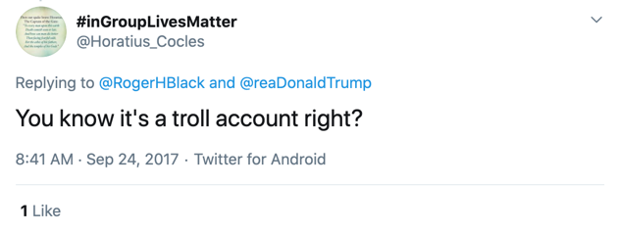
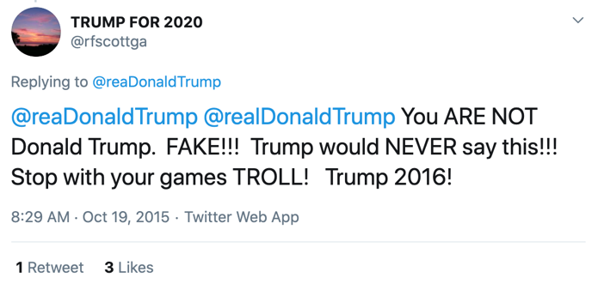
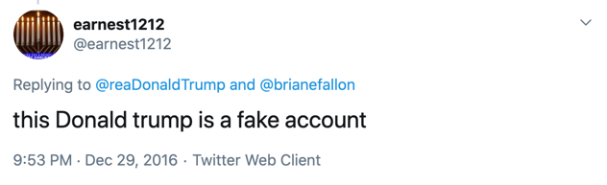
Some knew it was a fake account and tried to help
Note that these have low retweets and likes.

Slide 12
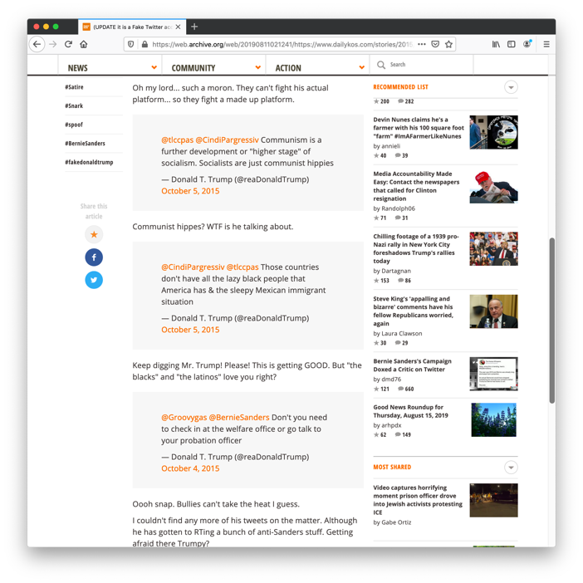
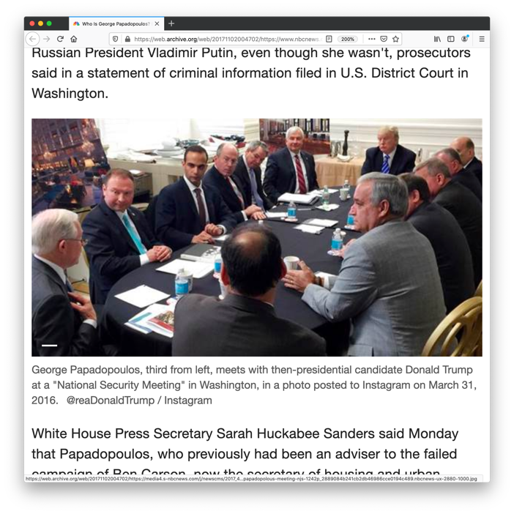
The press mistakenly endorsed @reaDonaldTrump as the real account name
In 2015, the Daily Kos thought tweets from @reaDonaldTrump were Trump speaking, but later issued a correction.
Endorsed by Media
In 2017, NBCNews endorsed @reaDonaldTrump as Trump’s Instagram account.
https://web.archive.org/web/20190811021241/https://www.dailykos.com/stories/2015/10/4/1427826/-Trump-goes-on-a-RED-SCARE-tirade-on-Bernie-Sanders
https://web.archive.org/web/20171102004702/https://www.nbcnews.com/news/us-news/who-george-papadopoulos-energy-expert-junior-trump-staffer-sought-be-n815826

Slide 13
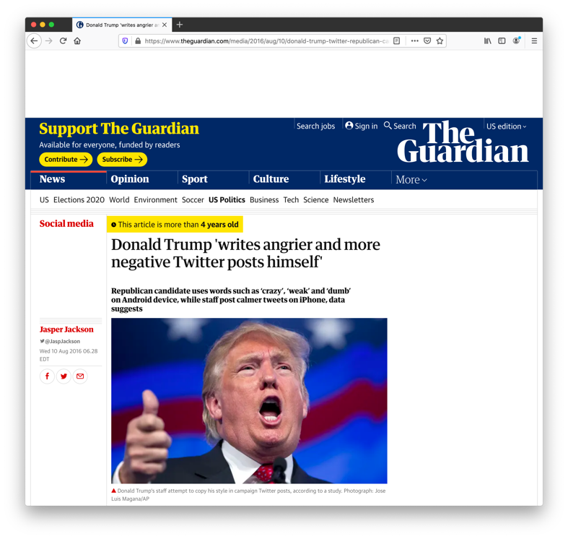
The Guardian wrote an article describing how Trump uses Twitter and used @reaDonaldTrump as his handle
They mention @reaDonaldTrump, so are they talking about the correct account?
Fortunately, the study they are summarizing uses @realDonaldTrump, so their conclusions are about Trump himself and not the fake account.
https://web.archive.org/web/20160810120355/https://www.theguardian.com/media/2016/aug/10/donald-trump-twitter-republican-candidate-android-iphone
Endorsed by Media

Slide 14
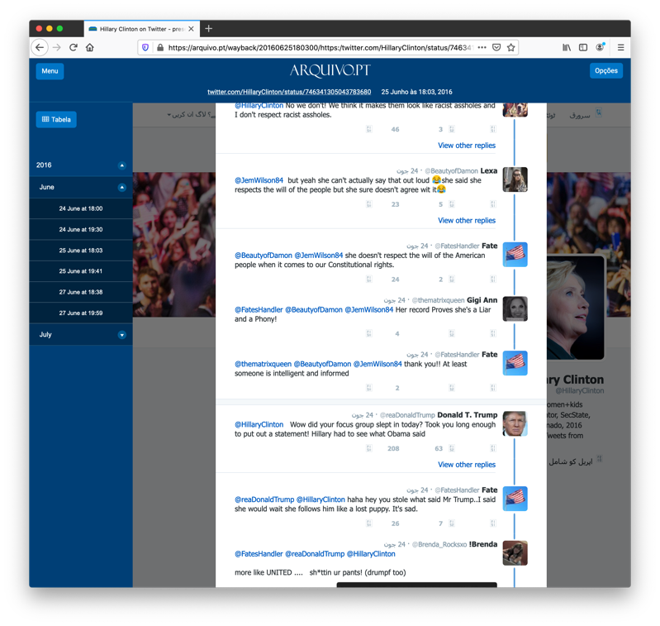
On June 2016 @reaDonaldTrump responded to Hillary Clinton
@HillaryClinton: "We respect the choice the people of the United Kingdom have made." —Hillary #BrexitVote
@reaDonaldTrump: “Wow, did your focus group slept in today? Took you long enough to put out a statement!”
More than 7 people continued to respond to this fake Trump account afterward. We do not know how many more because the rest of the conversation was not archived and the @reaDonaldTrump was suspended.
Acting Like Real Account
https://arquivo.pt/wayback/20160625180300/https:/twitter.com/HillaryClinton/status/746341305043783680

Slide 15
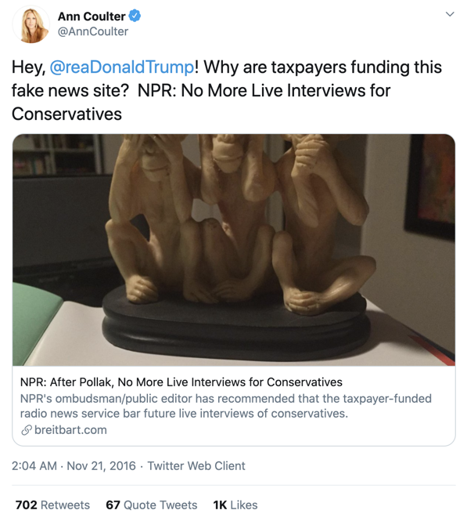
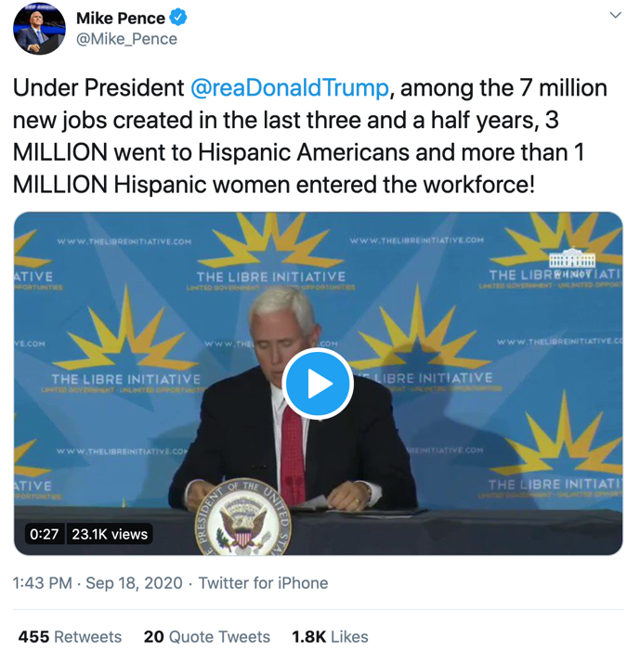
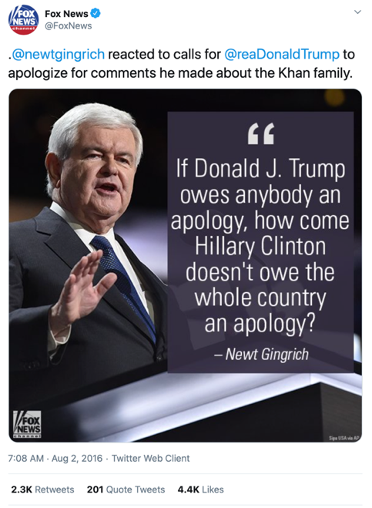
@reaDonaldTrump continues to be mistakenly used by verified accounts
Endorsed by Verified Accounts
https://archive.is/2XxzE
https://archive.is/UjwpK
https://archive.is/Yuasw
Notes:
These verified accounts act like they are mentioning Donald Trump.
Instead:
@realDonaldTrump is not notified
@reaDonaldTrump is endorsed as a legitimate account

Slide 16
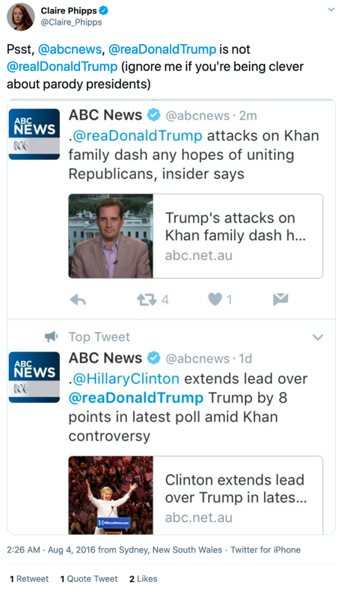
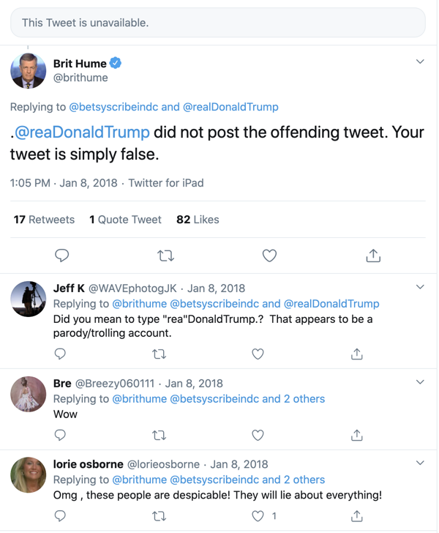
This confusion makes the conversation worse because some don’t know if a statement was made by the real Donald Trump
Who did Brit Hume intend to refer to? He is responding to an unavailable tweet
Did the fake account name fool Brit Hume or did he just misspell it?
We have 4 tweets from 2016 showing @abcnews using the wrong account?
Endorsed by Verified Accounts
https://archive.is/y66yI
https://archive.is/7xFOY

Slide 17
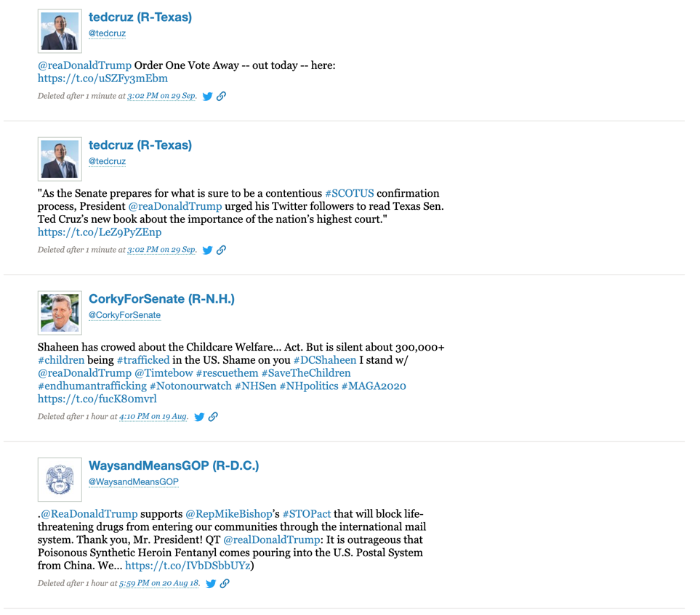
Politiwhoops has 4 deleted Tweets for @reaDonaldTrump
Senator
Same Senator
Senate Candidate
Source:
https://projects.propublica.org/politwoops/?page=1&q=reaDonaldTrump&utf8=%E2%9C%93
Republican Party Committee

Slide 18
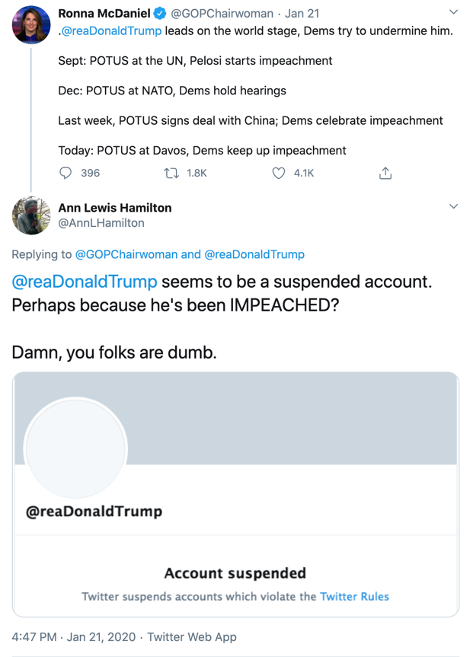
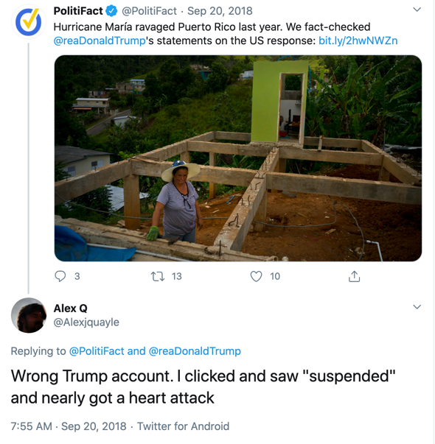
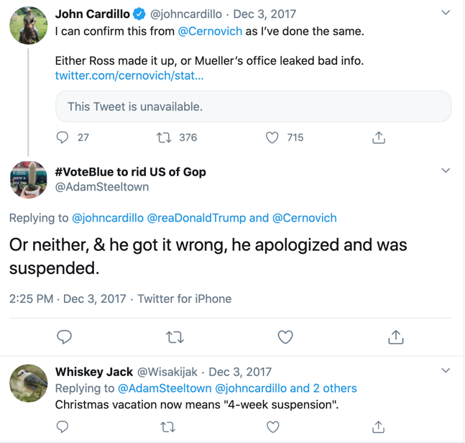
@reaDonaldTrump was suspended in 2017
For those who got the accounts mixed up, does this suspension feed the GOP narrative that Twitter is against right-wing politicians?
Not based on these responses.

Slide 19
@reaDonaldTrump is not the only fake Trump account
Twitter handle | Current Status | Created | Followers | Explicitly mentions parody in account description
@RealDonalDrumpf | Active | May 2013 | 103.9K | Yes
@reaDonaldTrump | Suspended | September 2015 § | 3,775 § | No
@realDonTrump | Active | June 2016 | 646 | No
@realDonaldT | Active | July 2015 | 213 | Yes
@realDonaldTrunp | Suspended | November 2012 § | 1,760 § | No
@realDonaldTramp | Suspended | October 2012 § | 38.1K § | No
@realDonaldTranp | Suspended | July 2016 § | 2,478 § | No
@redonaldtrump | Active | October 2015 | 1,194 | No
@realDonaldTrump (for comparison) | Active | March 2009 | 87.2M | No
§ According to mementos from archive.org:
https://web.archive.org/web/20170415015126if_/http://twitter.com/reaDonaldTrump
https://web.archive.org/web/20170821232944/https://twitter.com/readonaldtrump
https://web.archive.org/web/20180529044242if_/https://twitter.com/realdonaldtramp
https://web.archive.org/web/20170331023530if_/https://twitter.com/realdonaldtranp
Notes:
Politiwhoops
RealDonalDrumpf – 0
reaDonaldTrump – 4
realDonTrump – 0
realDonaldT – 0
realDonaldTrunp – 1
realDonaldTramp - 0
realDonaldTranp – 0
redonaldtrump – 0
realDonaldTrump – 400 (max?)

Slide 20
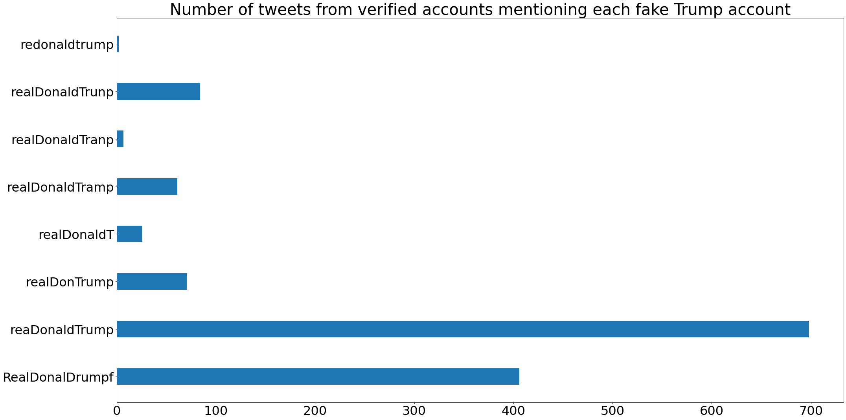
@reaDonaldTrump has the most mentions in tweets by verified accounts
2
84
7
61
26
71
698
406

Slide 21
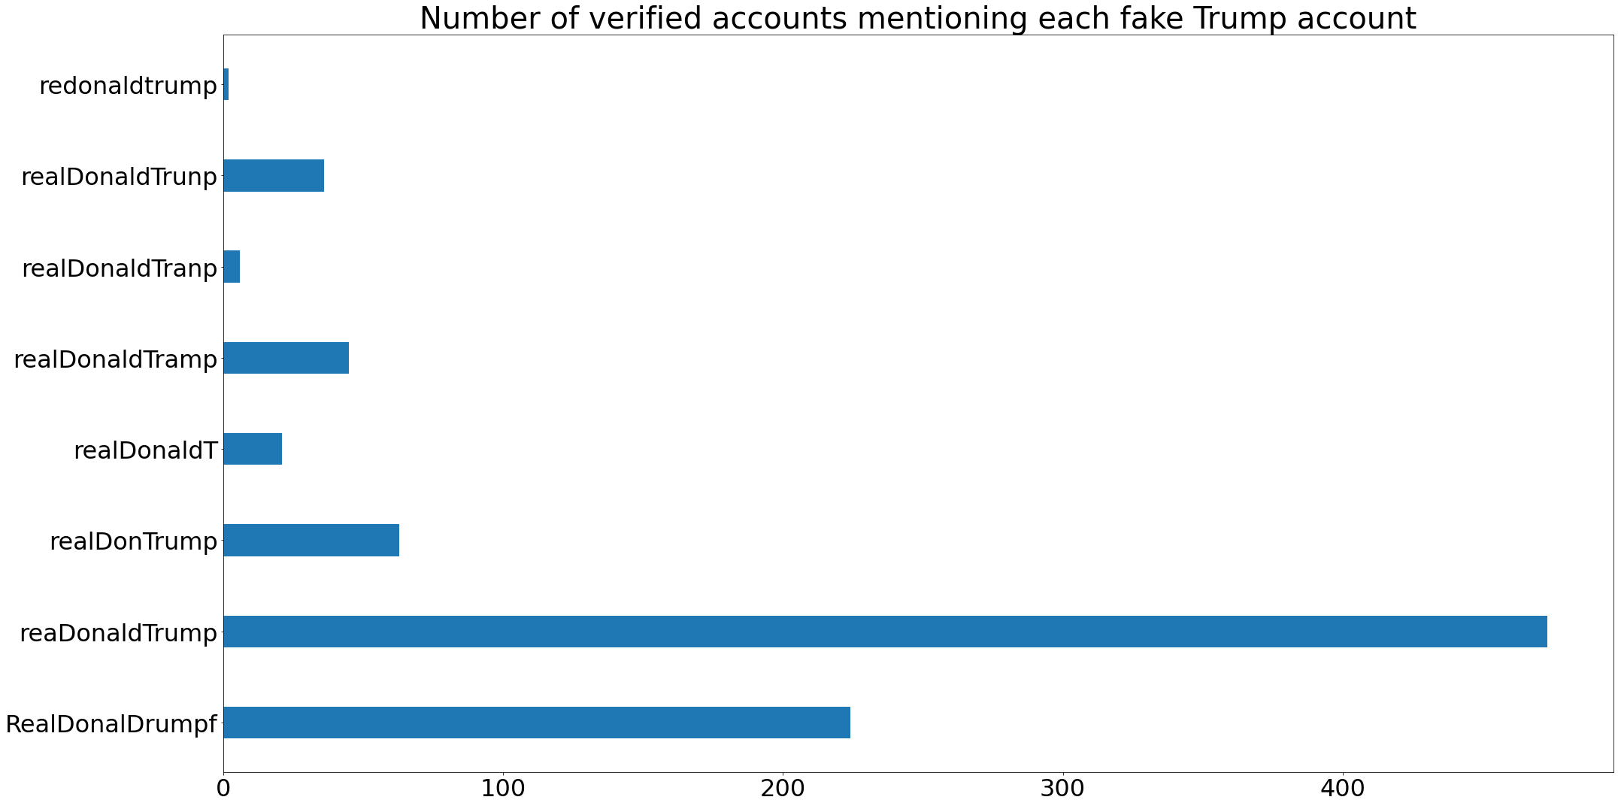
@reaDonaldTrump has the most verified accounts mentioning it
2
36
6
45
21
63
473
224

Slide 22
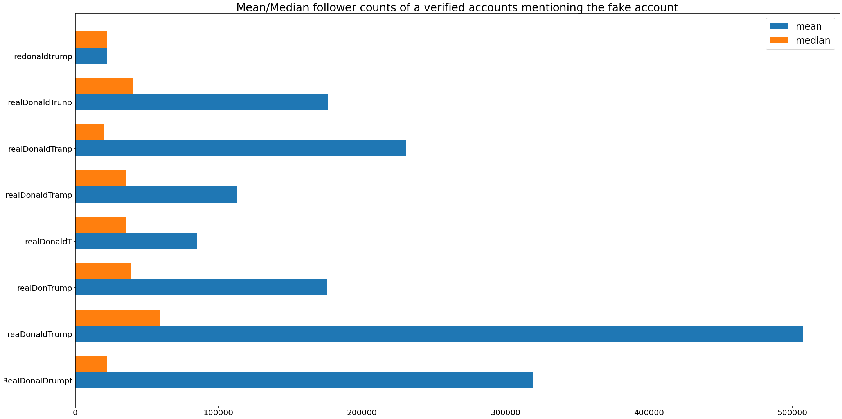
@reaDonaldTrump has fewer followers, but the verified accounts that share it have far more followers than those sharing other fake accounts

Slide 23
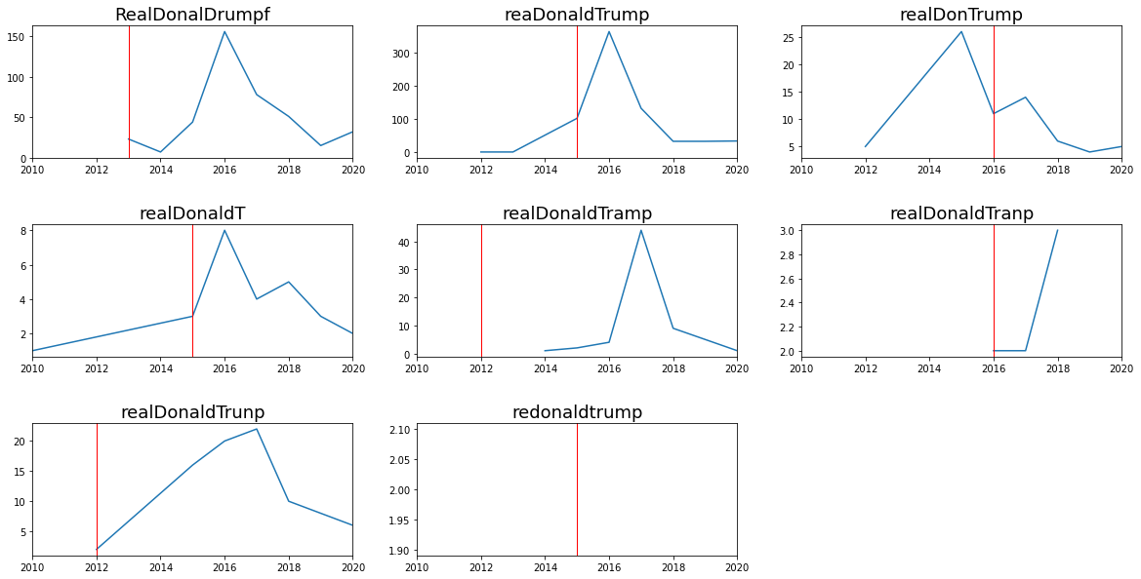
@reaDonaldTrump, @realDonTrump, and @realDonaldT were created after they were used by verified accounts…
The red line is the creation date of the fake trump account.
The blue line shows usage by verified accounts.
Did someone recognize a frequent misspelling and try to enter the conversation afterward?
Notes:
Peak usage years of fake accounts by verified accounts:
reaDonaldTrump – 2016
redonaldtrump - 2015
realDonaldTranp – 2018
realdonaldTrunp – 2017
realDonaldT – 2016
realDonaldTramp – 2017
RealDonalDrumpf – 2016
realDonTrump – 2016

Slide 24
In web archives with full-text search, the account @RealDonaldDrumpf is mentioned in the most mementos
Twitter handle | UKWA | Arquivo.pt | NLA
@RealDonalDrumpf | 262 | 136 | 66
@reaDonaldTrump | 84 | 85 | 8
@realDonTrump | 0 | 0 | 0
@realDonaldT | 42 | 10 | 0
@realDonaldTrunp | 2 | 5 | 1
@realDonaldTramp | 3 | 1 | 0
@realDonaldTranp | 0 | 0 | 0
@redonaldtrump | 0 | 0 | 0
@realDonaldTrump | 136,792 | 263,201 | 99,643
If we consider the number of mementos a proxy for popularity, then @RealDonalDrumpf is the most popular fake account, followed by @reaDonaldTrump.

Slide 25
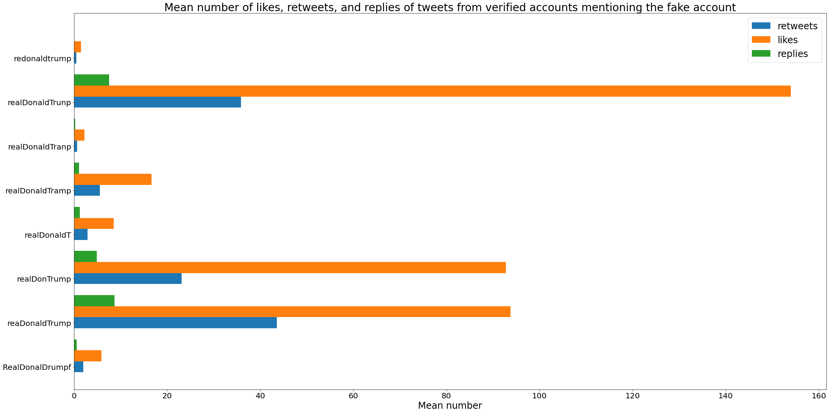
From verified accounts: @reaDonaldTrump has the highest mean # of retweets @realDonaldTrunp has the highest mean # of likes
This may also explain the reach of @reaDonaldTrump.

Slide 26
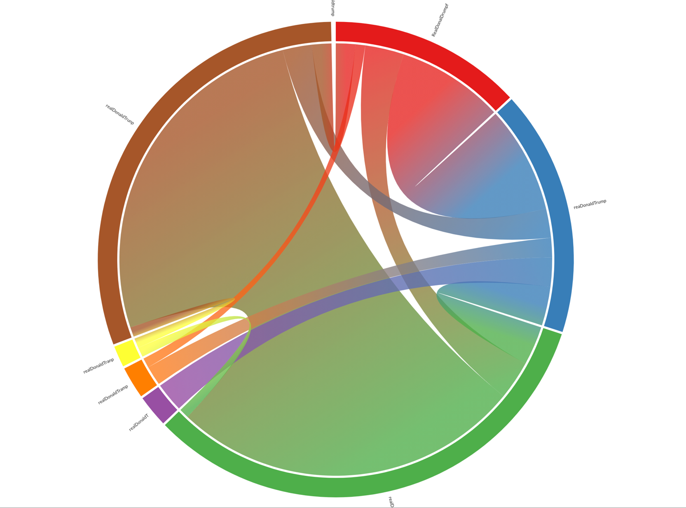
Some of the same verified accounts referenced different fake accounts in different tweets
reaDonaldDrumf
realDonaldTrunp
reaDonaldTrump
realDonaldTranp
realDonaldTramp
realDonaldT
realDonTrump

Slide 27
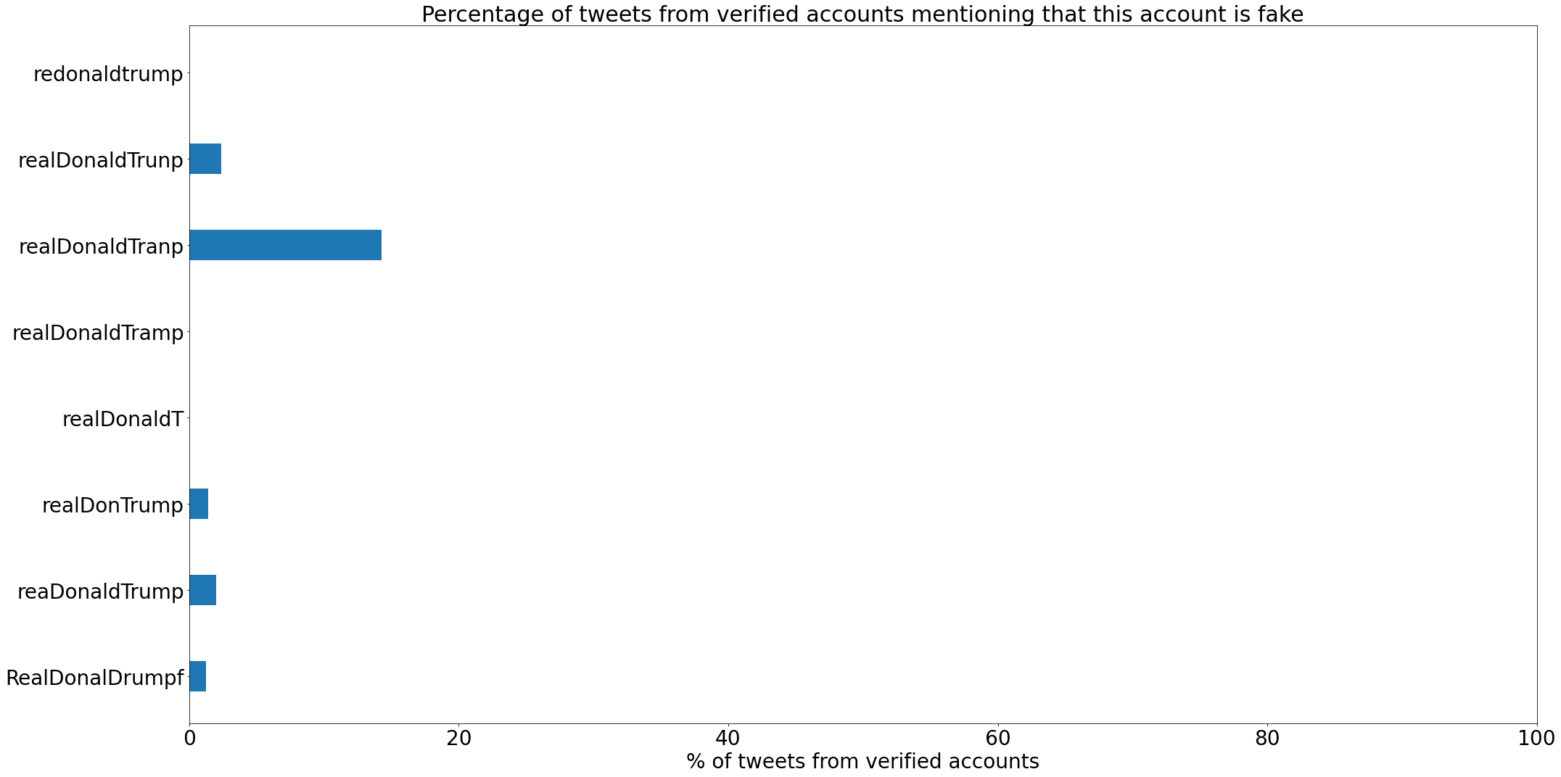
14.29% of tweets from verified accounts referencing @realDonaldTranp warned others that it was a fake account, and this was the highest percentage
0%
To determine if they were trying to warn their followers about the fake account, we searched tweets for the following strings:
fake Trump account
fake account
parody account
not the real Trump account
not his real account
#fakeaccount
2.38% (2/84 tweets)
14.29% (1/7 tweets)
0%
Each dataset is a different size, so percentages can be misleading.
0%
1.41% (1/71 tweets)
2.01% (14/698 tweets)
Note how @reaDonaldTrump does not have as many warnings.
1.23% (5/406 tweets)
Notes:
reaDonaldTrump: 0.02005730659025788
redonaldtrump: 0
realDonaldTranp: 0.14285714285714285
realDonaldTrunp: 0.023809523809523808
realDonaldT: 0
realDonaldTramp: 0
RealDonalDrumpf: 0.012315270935960592
realDonTrump: 0.014084507042253521

Slide 28
Future Work
Is there a correlation between the similarity of the Twitter handle and how many verified accounts mistake it for the real one?
Who runs these accounts?
What about misspellings like @realDonaldJTrump that were not accounts, but were used? They did not reach @realDonaldTrump, so how many messages were “misrouted”?
For what other celebrity accounts can this be done?
How many placeholder/squatting accounts exist for celebrities? How can we detect them?
How can we quantify the amount of damage done?
Perhaps Twitter might benefit from a redirect service for misspellings?

Slide 29

Summary
Multiple fake Trump accounts exist on Twitter
This could be dangerous because Trump issues policy from his tweets
How these fake accounts grow in usage:
misspellings seem to make it easy for fake accounts to be used by verified accounts
some were created after these misspellings were common
verified accounts give them legitimacy
even though the fake accounts had fewer than a few thousand followers, retweets by legitimate accounts with hundreds of thousands of followers extends the fake account’s reach
their use by the press further reinforces their legitimacy, leading to verified accounts using the fake account, and so on
Few tweets from verified accounts identify the fake accounts as fake
Who else might be affected by this?

